Slide 1
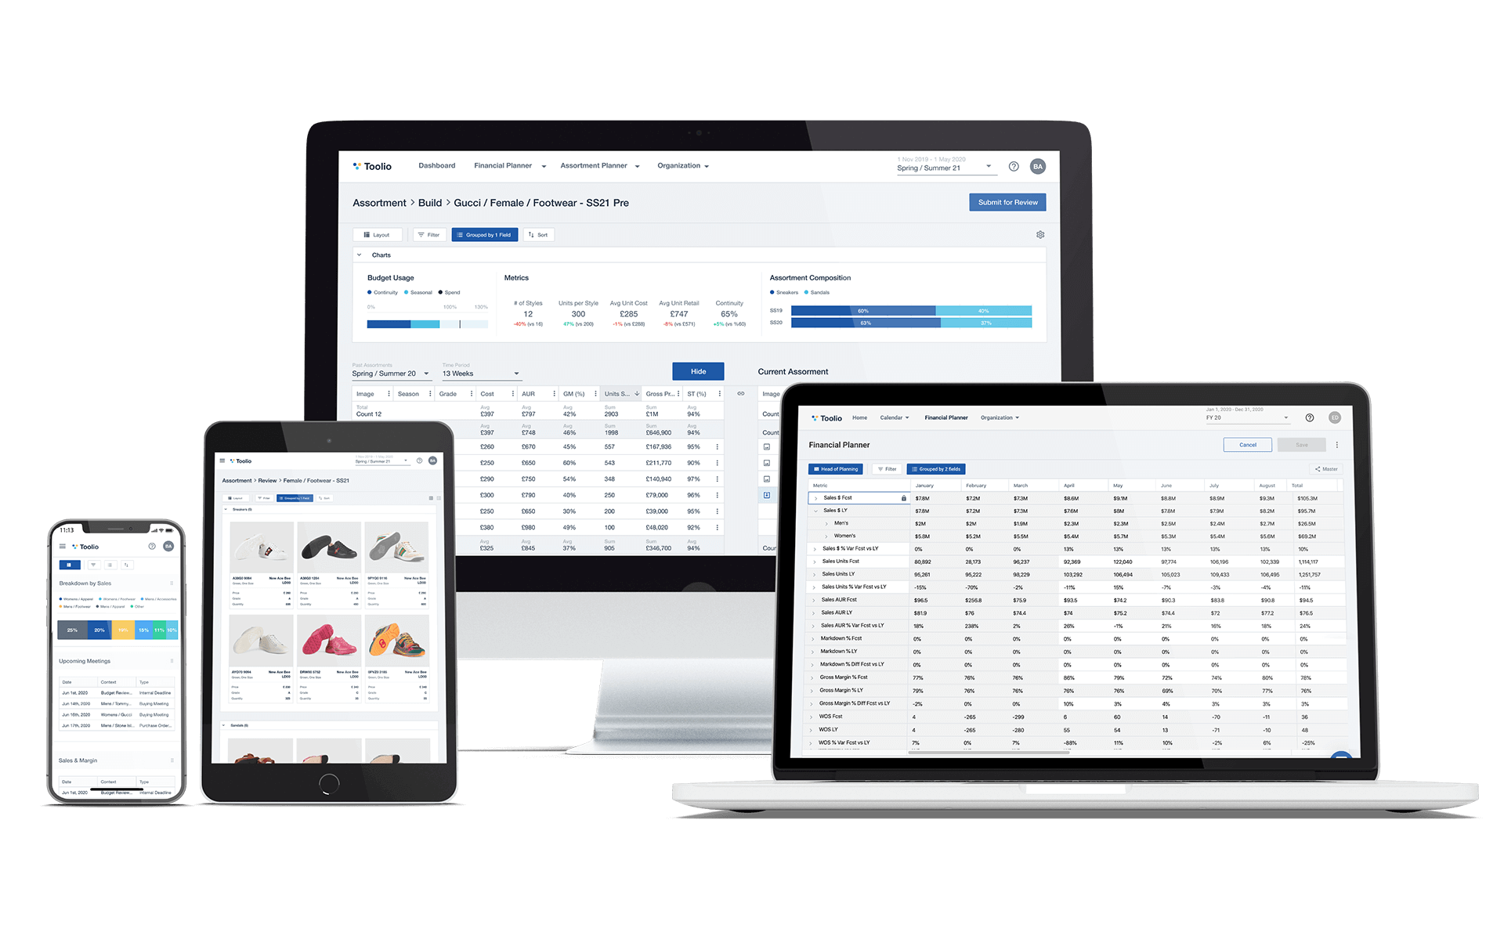
Prospecting Playbook

Slide 2
THIS IS ALL DUMMY DATA FOR EXAMPLE PURPOSES
FOR MORE SALES RESOURCES, VISIT GRANTPARKERCOACHING.COM

Slide 3
Contents
Prospecting Objectives, Activities & Metrics
Finding the Right Leads & Contacts
Prospecting Touch Plan
Messaging & Talk Tracks
Social Selling

Slide 4
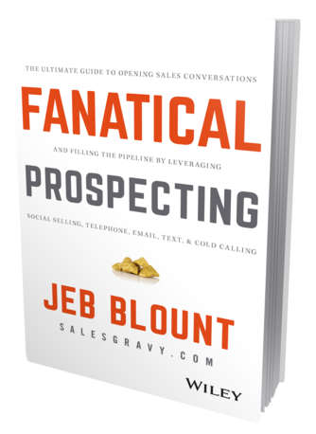
Fanatical Prospecting
“What's the secret that separates superstars from everyone else, and why do they consistently outperform other salespeople? Fanatical Prospecting.
Superstars are relentless, unstoppable prospectors. They are obsessive about keeping their pipeline full of qualified prospects. They prospect anywhere and anytime—constantly turning over rocks looking for their next opportunity. They prospect day and night—unstoppable and always on.”
-Jeb Blount, Fanatical Prospecting

Slide 5
The 30-Day Rule
“The 30-Day Rule states that the prospecting you do in this 30-day period will pay off for the next 90 days.
When you internalize this rule, it will drive you to never put prospecting aside for another day. The implication of the 30-Day Rule is simple. Miss a day of prospecting and it will tend to bite you sometime in the next 90 days. Miss a week and you will feel it in your commission check. Miss the entire month and you will tank your pipeline, fall into a slump, and wake up 90 days later desperate, feeling like a loser, with no clue how you ended up there.”
-Jeb Blount, Fanatical Prospecting

Slide 6
Prospecting Playbook
Prospecting Objectives, Activities & Metrics

Slide 7
Prospecting Objectives
Objectives
Build interest among focused target market
Build & maintain a constant pipeline
Create meetings for the leads to have a discovery with the Account Executive
Answer whatever high-level questions are required to get the meeting
Strategies
Personalized outreach to top target accounts
Establish strong knowledge of industry to be able to prospect the highest quality leads
Get in front of decision makers
Use creativity to overcome obstacles
Initiatives
Inbound lead qualification
Outbound prospecting
Referral Partners or “land and expand”
Tradeshows

Slide 8
Prospecting Goals & Metrics - BDR
Metrics
 | day | week | month
activities | 60 | 250 | 1,000
meetings | 7 | 36 | 143
Prospecting Cadence:
Maintain 50 daily leads worked
Follow the daily touch schedule for each lead
1x daily for 2 weeks
1x weekly for 4 weeks
1x monthly for 3 months
Try again after 6 months
Goal: Get to yes, no, or Bad Timing ASAP and MOVE ON
Consistently filter out Leads as they change Lead status to DQ, Revisit or SQL

Slide 9
Prospecting Playbook
Finding the Right Leads & Contacts

Slide 10
250+ employees
Blue collar / Gray collar
Self-funded health plan
Innovative leadership
frustrated with the system
dread renewal season
willing to go outside the box to get results
Title = CFO/CEO, President, Vice President
Key Persona 1: Employer

Slide 11
250+ employees
Blue collar / Gray collar
Sell Self-funded plans
Innovative leadership
frustrated with the system
dread renewal season
willing to go outside the box to get results
Title = CFO/CEO, President, Vice President
Key Persona 2: Broker

Slide 12
Ideal Broker Profile
Attribute | Ideal Customer Attribute
Pains/Challenges | Cannot differentiate themself in the market because BUCAH is a commodity Need to respond to employer’s demand for flatter costs & richer benefits Maybe understands BUCAH self-funding, but not necessarily an expert on independent/unbundled plan design
Initiatives and goals | Expand book of business by winning new clients Transition more groups to independent self-funding Make a name for themselves at their agency or in their community/industry Meet rising client demand, especially financial after COVID-19 Keep old clients who may be at risk
Hypothesis of Need | A vetted partner who uses 21st Century technology to provide unique cost containment and member experience solutions, while keeping work off their plate
Decision Making Factors | Stop loss numbers Client decision or if the client likes the idea Sign-off from the account management team that this solution will function Some agencies have required partner lists - XYZ must pass an RFP
Budget | 15-45% savings over incumbent proposal

Slide 13
Ideal Broker Profile
Our ideal broker works for a US based, mid-sized insurance agency or benefits consultancy. They have a proven interest in transparent, independent self-funding, even if it is not the majority of their book of business. Their market size is over $10MM in annual revenue, and has a suite of technology and financial services to offer clients.
The broker we are looking for understands that independent self-funding is the only true way to reduce costs, and wants to distance him or herself from the BUCAH status-quo. This is either because they’re sick of it, or they want a wedge to differentiate themselves in the market.

Slide 14
Finding the Right Broker Personas
Individual Contributors | Executives | End Users
Producer Consultant Account Executive Broker / Advisor | CEO Owner Partner President Vice President, Employee Benefits | Account Manager Marketing Specialist DQ Customer Support Specialist

Slide 15
Finding the Right Contact Information
Contact Sources | Contact Info Sources
LinkedIn LinkedIn Sales Navigator Searches LinkedIn Groups Trade Groups / Associations BenefitsPRO Magazine | ZoomInfo (by geography, industry, etc.) Broker’s website LinkedIn

Slide 16
Prospecting Playbook
Touch Plan

Slide 17
Prospecting Touch Plan
Touch Plan:
Maintain 50 daily leads touched
Follow touch plan below
1x daily for 10 days
Then move to 1x per week for 4 weeks
Then move to 1x per month for 3 months
Then move to 1x per quarter forever, re-start after 6 months
Goal: Get to yes (meeting), no (DQ’d), or revisit (when?) as fast as you can
Consistently filter out Leads List as they change status to DQ or Connected
Tips:
Be sure to follow consistent prospecting cadence among target accounts as outlined in slides
Work a full day every day (except vacay days)
Put call and email blocks on your calendar EVERY DAY
Beyond calling out, consistently be prospecting for 5-10 new leads a week to be adding to the system

Slide 18
Prospecting Touch Plan
Day 1 | Day 2 | Day 3 | Day 4 | Day 5
Google them, confirm job & title Call 1, no VM | Call 2, no VM | Call 3, leave VM Confirm the number you’re using gets to them Use ZoomInfo or other to solidify contact info | Ask the receptionist Email 1 (template) | LinkedIn connect Prospect someone else in the account (keep on the side for now)

Slide 19
Prospecting Touch Plan
Day 6 | Day 7 | Day 8 | Day 9 | Day 10
Call 4, leave 2nd VM OR if they accept LI (LinkedIn) Connection Request) send LI Direct Message | No call today At this point may want to examine progress with manager, determine next steps | Call 5 Email 2 (template) | Call 6 | Break-up email Move to weekly call cadence

Slide 20
Qualifying

Slide 21
Qualifying criteria - “Must Be True”
Company is in healthcare industry
Company provides care, or a part of the member experience, today.
If they are earlier stage than this: company has a thesis on how to do the above in a better way.
Company has a legitimate website
Contact is the decision maker, or working on behalf of the decision maker

Slide 22
Employer Discovery Questions
How many lives? (minimum is 100, goal is 250)
Who are they using as a network?
Who are the major hospitals?
How is that working for them? What would they like to see change?
What are the group’s goals?
What is the group demographic?
Their current situation is X. Are they more likely to step into fully insured, or self-funded?
What are their ultimate goals for their health plan (proactively medical management to improve health outcomes, lower costs, seamless member experience, minimum coverage)?
PBMs: What's important to them (or to you) in a PBM? We can also include specialty Rx vendors- Do you know if there are any specialty drugs that we should be taking into consideration?
What other add-on vendor partners would be important (disease management, teladoc, direct primary care)
When will they make their final decision? We have a Member Experience team who can help with open enrollment and member onboarding. Do you think that would be interesting to this group?
What are the other TPAs in consideration? In your mind, what boxes does XYZ check that the other candidates might not be offering (aka "why involve XYZ in this RFP?")
When is the next time you are talking to them? Is there an opportunity to have XYZ come in and tell our story?

Slide 23
Broker Discovery Questions
What made you curious to get on a call with us today?
Tell me about your clients - what’s their average size, what percent of your book is self-funded with BUCAHS vs. with independent TPAs?
Tell me about your agency- how many producers are there with how many clients each? How many of these clients would be good candidates for independent self-funding?
How do you evaluate new Partners? What are the specific criteria you look at? What do you hate about your partners?
How do you prefer to work with your vendor partners- Are you looking for guidance/hands on, or a plug-and-play option?
What are the key solutions you're trying to solve for your clients this year? How are you delivering results to them currently? What’s missing or not working? eg. Better member experience, better cost outcomes, long tenure w/ our clients.
Where are your clients located? What’s the healthcare landscape around them?
The best way to get to know each other is by working on a case together. Do you have a 100+ group with good data that we could look at together?

Slide 24
FAQ’s and Common Objections

Slide 25
FAQ’s about our company
How much is your average savings per employer group?
What PBMs do you work with?
How old is your company? How many lives do you cover today?

Slide 26
Common objections & how to overcome them
We don’t work with start-ups
We are backed by industry leaders who all have fantastic track records of success in the industry
We need to use our own vendors & services
Our secret sauce for member experience & savings is based on the amazing combination of partners in our health plan.

Slide 27
Call Scripts

Slide 28
Call Script: Neglected leads
This is Anthony at XYZ health. Did I catch you at a bad time?
You had some RFPs with us in the past - does this sound familiar?
Looks like there were a number of RFPs back then. Are you all still working with unbundled, independent plans?
We're seeing incredible success with unbundled plans - around $4,800 savings per employee, and our renewal rate is -1%. Would you be interested in setting up a call this week or next to get introduced?

Slide 29
Call Script: Neglected lead VM
This is Anthony at XYZ health.
Calling in regards to some RFPs we’ve worked on in the past.
Please give me a call back when you get this - ###-###-####
-------------
I’m calling in regards to XYZ group.
Please give me a call back when you get this - ###-###-####

Slide 30
Call Script: Webinar lead
This is Anthony at XYZ health. Did I catch you at a bad time?
Excellent. Are you familiar with XYZ Health?
Excellent. Seems like you work with clients on unbundled, independent plans. Is this still the case?
Nice. I was calling to see if you have availability over the next week or two to schedule a discovery meeting with my boss and we can do a refresher of some of the unique features that XYZ is able to provide to self-funded clients?

Slide 31
Call Script: Webinar lead
This is Anthony at XYZ health. Did I catch you at a bad time?
Excellent. Are you familiar with XYZ Health?
The reason I’m calling today is I see you came to a couple of webinars with XYZ last year, but nobody here ever really called you or followed up.
What was your interest in XYZ Health?
Oh that’s awesome. Would you like to set up a quick refresher call with our team to learn about what we’re offering and some of the successes we’ve been having this year?

Slide 32
Call Script: Tradeshow lead
This is Anthony, I am head of business partnerships at XYZ Health. Did I catch you at a bad time?
I saw you came by our booth at ABC Conference, and we didn’t get a chance to connect. I was hoping to learn more about [BROKERAGE].
Are you familiar with XYZ Health?
Is there a time this week we could set up an intro call?
How did you like the show?

Slide 33
Terms & Definitions

Slide 34
Lifecycle Stages
Lead Trying to connect
Marketing Qualified Lead Trying for discovery & qualification
Sales Qualified Lead Trying for case
Opportunity RFP
Customer Closed won case
Other Disqualified
Subscriber Not qualified (yet)

Slide 35
Lead Status
New Untouched
In Progress Trying to connect
Connected Connected
Rejected Not qualified
Bad Timing Revisit later

